Slide 1
Game of the Year Candidate Prediction Model
Analytics and Discovery Informatics – Fall 2024
By Syed Hashim Raza

Slide 2
TABLE OF CONTENTS
01
02
03
Introduction
Approach
Data Cleaning and Processing
04
05
06
Methodology
Practical Application
Conclusion and Next Steps

Slide 3
01
Introduction
Identifying Key Success Factors in Award-Winning Games

Slide 4

Introduction and Motivation
Award is presented each year to most popular game based on multiple criteria. Creativity, story, gameplay, graphics, sound, and popularity among players.
The gaming industry is a cultural powerhouse, with GOTY nominations symbolizing critical and popular success.
This project aims to predict Game of the Year (GOTY) candidates/nominations on the Steam platform using Machine learning.
Steam is one of the biggest digital distribution platform, offering comprehensive data on game engagement, reviews, and community interactions.
The aim is to build a supervised learning model using data provided by Steam and third-party analytics resources to classify games as potential GOTY nominees based on features like genre, player engagement, and user reviews.
Notes:
The award is presented annually by ‘The Game Awards’.
Key questions: what makes a game resonate with audiences? How do design, gameplay and player engagement contribute to a game’s GOTY status.
Personal motivation, since I am a huge fan of video games, especially online competitive ones. Spent a LOT of time playing games via steam.

Slide 5
02
The Approach
Problem Framing, Data Framing, Objective Framing

Slide 6
Approach Framing
Problem Framing
Predicting a game’s potential for GOTY nomination
Features such as genre, engagement stats, reviews assuming that these aspects are fundamental in determining the critical reception
Data Framing
The dataset captures each game’s characteristics, player statistics, review scores, release information, price
Target label was engineered by looking at past year game award winners and nominations, and then added to the dataset in a binary form (0 or 1)
Allows data to be structured into a feature matrix X, and target vector y.
Objective Framing
Use metrics such as AUC-ROC to assess model’s accuracy in distinguishing, given an imbalanced dataset
Precision and recall metrics will help monitor the model’s capability in identifying true nominees

Slide 7
03
Data Collection, Cleaning, Processing
The following slides will describe the process

Slide 8


Data Collection
Total of 101,035 games listed on Steam as of June 2024.
SteamSpy, a third-party analytical tool was chosen as the primary data collection target as it provides aggregated data about individual game on Steam
Steam API was chosen to compliment the data collected via SteamSpy. Steam API provides granular data about each game.
Using both sources enriches the dataset by combining the broader audience’s insights with detailed, real-time game attributes
For the project’s purposes, top 5000 games of all time were targeted – All the games would cause our dataset to be very noisy.
SteamSpy due to its aggregated user metrics for each game helped filtering the data collection to the top 5000 played games.
Notes:
Both sources were used to enrich

Slide 9
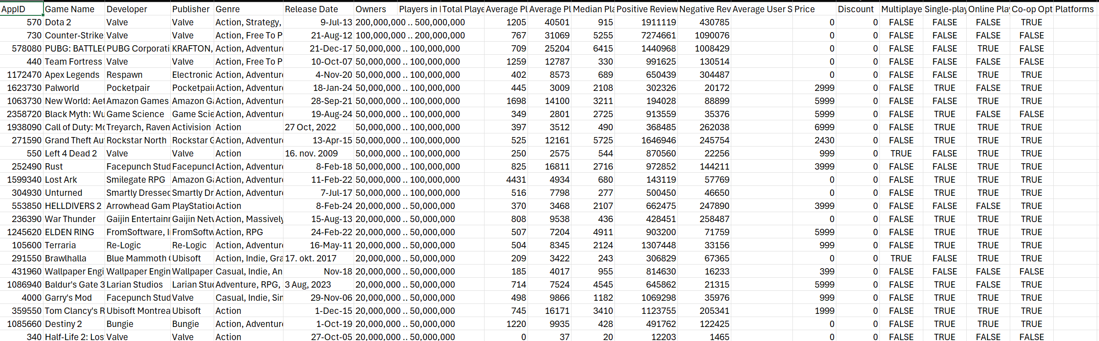
The Initial dataset

Slide 10
Data Cleaning
Due to the aggregated nature of the SteamSpy collection process, various games were duplicated due to different versioning, regional releases, and update in player count snapshots at different time stamps.
After removing duplicates, we were left with 997 unique games in the dataset.
Many games did not have release dates, so Steam API was used to retrieve that information for the games in my dataset to be integrated.
Some games still did not have release dates extracted from Steam API, so they were dropped, leaving the dataset with 933 total observations.
Some feature columns were completely null, so they were removed.
A few games had missing publisher/developer information; it was imputed with ‘unknown’.
Some genre tags were in a different language, and some had symbols – that was translated and fixed respectively.
Notes:
Both sources were used to enrich

Slide 11

Data Processing
Owners of a game was in a range, due to the aggregated nature of the data retrieved from SteamSpy – Average was taken.
Multiplayer features of the game were initially split into 4 feature columns – this was aggregated into a single multiplayer option column for simplicity.
Release Date was split into Release Year and Seasons (Fall, Winter, Spring, Summer) and one-hot encoding was performed.
Games had multiple genre tags (23) as features, with some games missing that information altogether – Genre’s were split into multi-label one-hot encoded features columns.
The dataset did not have a target label, which was Game of the Year nomination – ‘The Game Awards’ historical data was taken, and the target label was manually integrated in the dataset as a binary label (0 or 1).
Each year about 4-5 games are nominated for the award – our target labels include 30 historical game of the year candidates (1 in the target label).
Notes:
Both sources were used to enrich

Slide 12
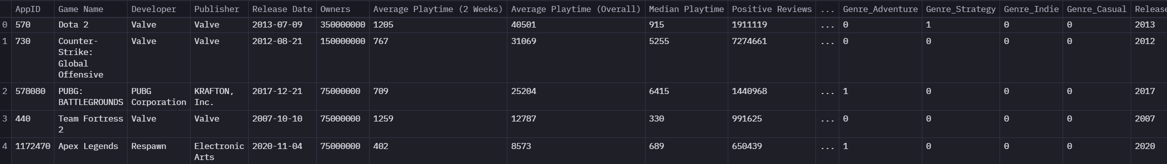
Final Dataset
The final dataset has 42 feature columns and 1 target label column.
For a more detailed look at the data collection and processing, please check the ‘project proposal – dataset summary document’.
Below is a screenshot of the final dataset. All the columns could not be added due to space limitations.

Slide 13
04
Methodology

Slide 14
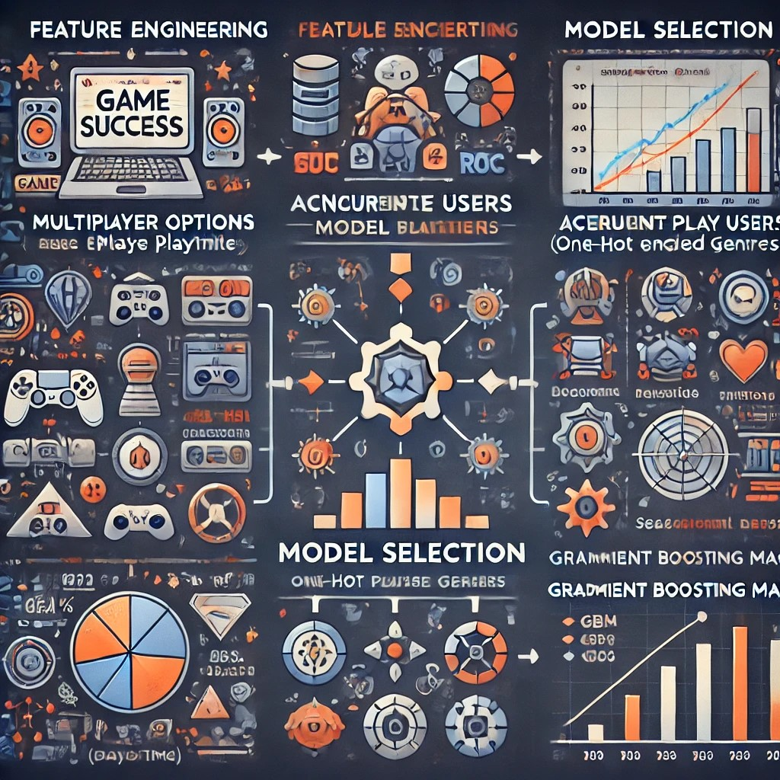
Methodology
Feature engineering employed to capture critical aspects of a game’s success. Key features include multiplayer options, average playtime, concurrent users, one-hot encoded genres and seasonal release dates – allowing the model to recognize patterns.
Base model chosen as Logistic regression and Decision Trees. Logistic regression provides interpretability in binary classifications. Decision Trees capture non-linear relationships
Complex model chosen as Gradient Boosting Machine (GBM) – useful for moderately sized datasets and preferred choice for imbalanced datasets.
Evaluation Metrics: AUC-ROC as primary metric for distinguishing nominees vs non-nominees, with precision, recall, and F1 score as supplementary metrics.

Slide 15
05
Practical Approach

Slide 16


Practical Application
The logistic regression model can be used to support decision-making in game development and marketing strategies by identifying features that most likely influence nomination potential.
Developers can prioritize resources and design elements that align with award-winning attributes and predictions based on the model.
Important features for the model’s interpretability:
Review Scores (Positive association)
Player Engagement (Positive association)
Genre (Variable association)
Release Timing (positive association)
Notes:
For example, if the model shows that high user ratings and longer average playtime have a strong positive association with GOTY nominations, developers might focus on enhancing gameplay quality and engagement.
Or certain genres that are more popular in a given period of time for example. Review Scores (positive association): Higher positive reviews likely indicate quality and enjoyment, factors associated with GOTY nominations.
Player Engagement (positive association): Metrics like average playtime and concurrent players often reflect sustained interest, suggesting high replay value and engagement, which aligns with GOTY standards.
Genre (variable association): Certain genres might correlate strongly with GOTY nominations based on recent trends (eg., RPGs or action-adventure games).
Release Timing (positive association): Games released in certain seasons or close to the award cycle may gain more attention, enhancing nomination chances.

Slide 17
06
Conclusion and Next Steps

Slide 18

Conclusion
Build a predictive model for GOTY nominations on Steam data using key game features.
Support game developers and marketers in identifying success-driving elements.
Data-driven insights; guide decision-making in game design and marketing .
Address the growing need for data-based predictions in gaming.
Next Steps
Start with logistic regression to understand the feature importance. Use Decision Trees to understand relationships better.
Continue working on data processing, and feature engineering if needed.
Use Gradient Boosting for handling imbalances
Evaluate the model using AUC-ROC and Precision-Recall to ensure model accuracy on imbalanced data
Notes:
For example, if the model shows that high user ratings and longer average playtime have a strong positive association with GOTY nominations, developers might focus on enhancing gameplay quality and engagement.
Or certain genres that are more popular in a given period of time for example. Review Scores (positive association): Higher positive reviews likely indicate quality and enjoyment, factors associated with GOTY nominations.
Player Engagement (positive association): Metrics like average playtime and concurrent players often reflect sustained interest, suggesting high replay value and engagement, which aligns with GOTY standards.
Genre (variable association): Certain genres might correlate strongly with GOTY nominations based on recent trends (eg., RPGs or action-adventure games).
Release Timing (positive association): Games released in certain seasons or close to the award cycle may gain more attention, enhancing nomination chances.

Slide 19
THANKS
Please, keep this slide for the attribution

